Slide 1
Spectrum Lab:
An online learning environment for authentic inquiry

Slide 2
Welcome to Spectrum Lab
What can light reveal about an object or phenomenon, beyond what our eyes can see?
1
2
3
4
Notes:
This is the instructor slideshow to project in class or screen share remotely.
Notes to the teacher will be found below the slides here.
BLACK = steps to follow or questions to ask the class.
GREEN = answers to questions posed, for the teachers’ reference. (If your classroom workflow involves sharing this slideshow directly with students, please distribute the .pdf version which does NOT give the answers).
GRAY = source image URLs and other references
These opening slides give examples of questions across a wide variety of topics that can be answered using spectra.
NOTE: The curriculum will explore some but not all of the phenomena described in this section. The examples are meant to show the breadth of how spectra are important in a variety of fields.
If you are limited in the amount of time you have available, feel free to choose a few specific examples and skip the other slides.
Materials needed
For each student you will need:
Red, blue, and green theater gels. They can be cut into ~2 cm squares and taped to an index card or book mark.
Homework suggestion
Complete any unfinished challenges from today’s session

Slide 3
Astronomy
Objects in space are thousands, millions, or billions of light years away from us.
Astronomers use the light that objects emit to understand all kinds of characteristics of distant stars, planets, and galaxies.
1
2
3
4
Notes:
Image: https://today.uconn.edu/2020/11/uconn-researcher-architect-astronomical-survey-making-observations-toward-new-understanding-cosmos/#
In this unit, students will learn how spectra can be used to determine color, temperature, and composition of objects -- Astronomers do the same thing. (The Exoplanet final project is an example of this kind of analysis.) Astronomers also use spectra to determine all kinds of other properties including motion, density, magnetic fields, and more.

Slide 4
Chemistry
Light helps chemists identify the composition of a substance.
Light helps us understand the structure and behavior of atoms and molecules.
1
2
3
4
Notes:
Image : https://www.photonics.com/Articles/Spectroscopy_Guides_Precision_Medicine/a66410
Because atoms and molecules emit and absorb light at characteristic wavelengths and energies that depend on subatomic and molecular structure, spectra are a key analytic tool for understanding chemical composition.

Slide 5
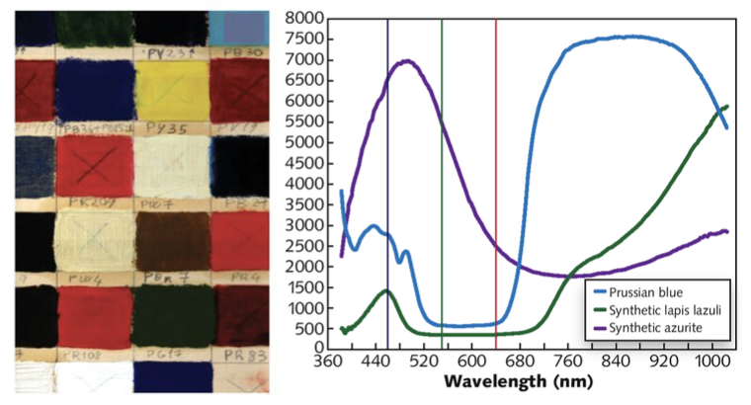
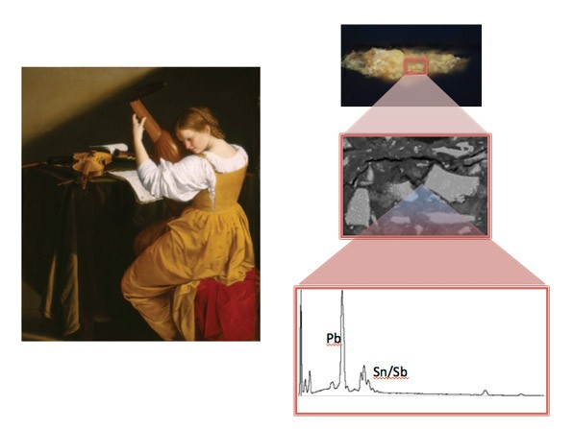
Art History
Light helps historians identify forged paintings.
1
2
3
4
Notes:
Image 1: https://digital.laserfocusworld.com/laserfocusworld/202010/MobilePagedReplica.action?u1=DA1020&utm_source=newsletter&utm_medium=email&utm_campaign=TXLASE201009002&utm_content=gtxcel&pm=2&folio=34#pg36
Image 2: https://www.nga.gov/conservation/science/chemical-characterization-of-pigments-in-art.html
Pigments and dyes can be analyzed by their spectra -- pigments created from plants or other natural materials in the 17th century will have different reflection and absorption characteristics than newer synthetic pigments.

Slide 6
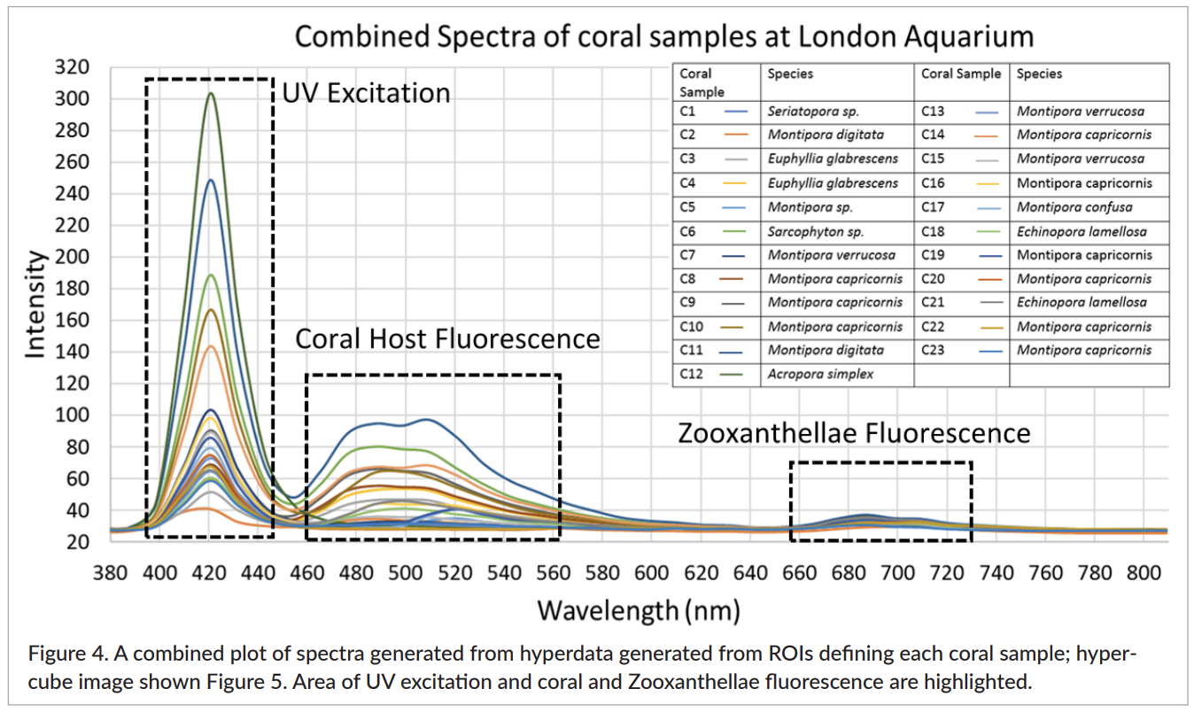
Earth Science
Light helps scientists diagnose the health of our oceans and forests.
1
2
3
4
Notes:
Image 1: http://plymsea.ac.uk/id/eprint/8259/1/Teague%20et%20al%202019%20JSI.pdf
Image 2: https://www.spectroscopyeurope.com/article/applied-marine-hyperspectral-imaging-coral-bleaching-spectral-viewpoint
Coral or forest canopies that are healthy reflect light differently than when they are damaged.

Slide 7
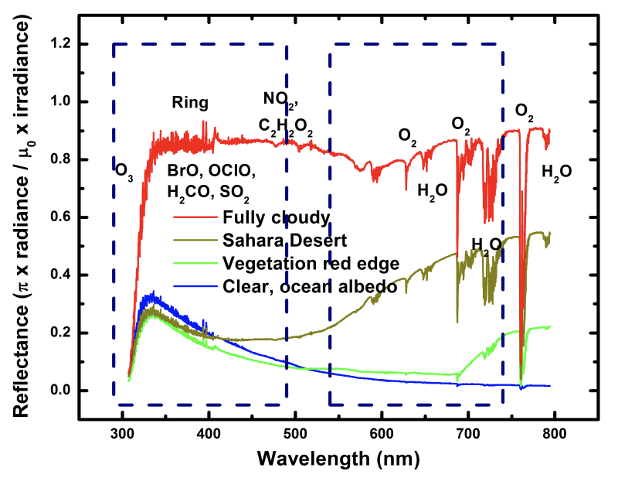
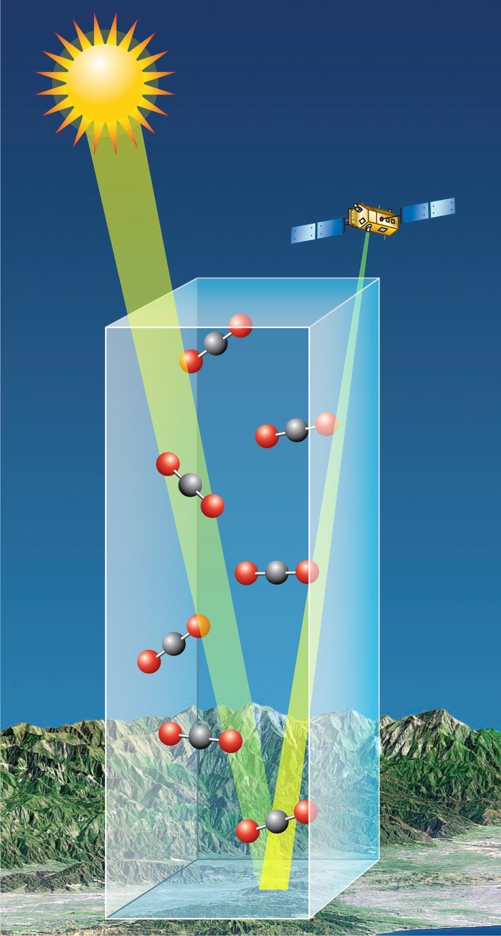
Environmental Chemistry
Light helps scientists understand what’s in the air we breathe so we can reduce our exposure to harmful pollutants.
1
2
3
4
Notes:
Image 1: http://tempo.si.edu/TEMPO-FactSheet.pdf
Image 2: https://ocov2.jpl.nasa.gov/galleries/graphics/#images-10
Satellites can measure molecules that are in the atmosphere by looking at the reflected sunlight that gets absorbed by these molecules.

Slide 8
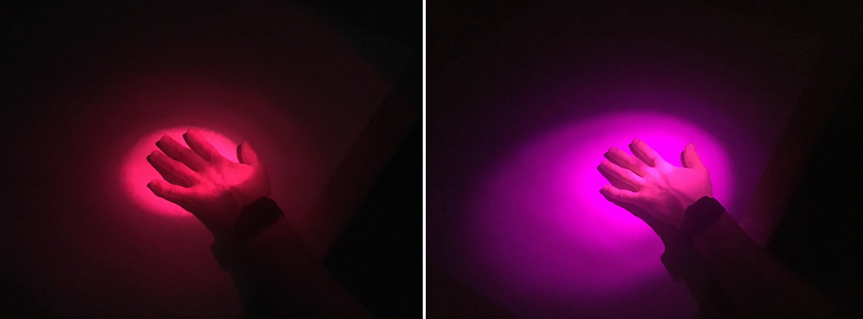
Theater Lighting Design
Theater lighting designers use their understanding of light and color to create different moods and effects on a stage.
1
2
3
4
Notes:
Image: https://www.rosco.com/spectrum/index.php/2016/04/how-to-properly-choose-a-color-filter/
To get the desired lighting effects on stage, designers need to understand how costumes and sets reflect and absorb light as well as how theater light sources and colored filters change the look and feel of the set. (The Fishtank project explores these ideas)

Slide 9
Module 1: Light
How does the interaction of light and matter affect the colors we see?
1
2
3
4
Notes:
Invite students to a brief discussion:
What do they know about the different ways that light can interact with light and matter?
How do they think we see color?

Slide 10
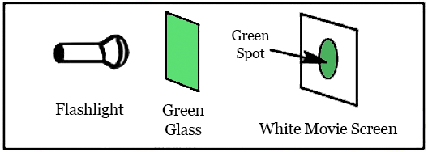
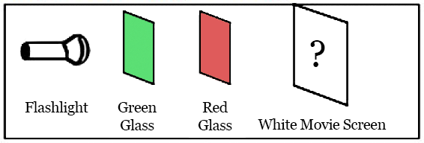
POLL When green glass is placed between the flashlight and the white movie screen, a green spot appears on the screen. If both a green glass and a red glass are placed between the flashlight and the movie screen, what will happen to the spot?
It will turn green.
It will turn yellow.
It will turn brown.
It will turn red.
It will disappear.
1
2
3
4
Notes:
Remote teachers can conduct this as a Zoom poll.
Hold a vote (with no discussion) to get students to start thinking about this.
Do NOT reveal the answer here. We will revisit this question later.

Slide 11
Color Filters:
Predict and Investigate
How do colored filters work?
1
2
3
4
Notes:
This slide introduces the following section. Ask students to keep their red, green, and blue colored filters on the desk or closed in an envelope for now.

Slide 12
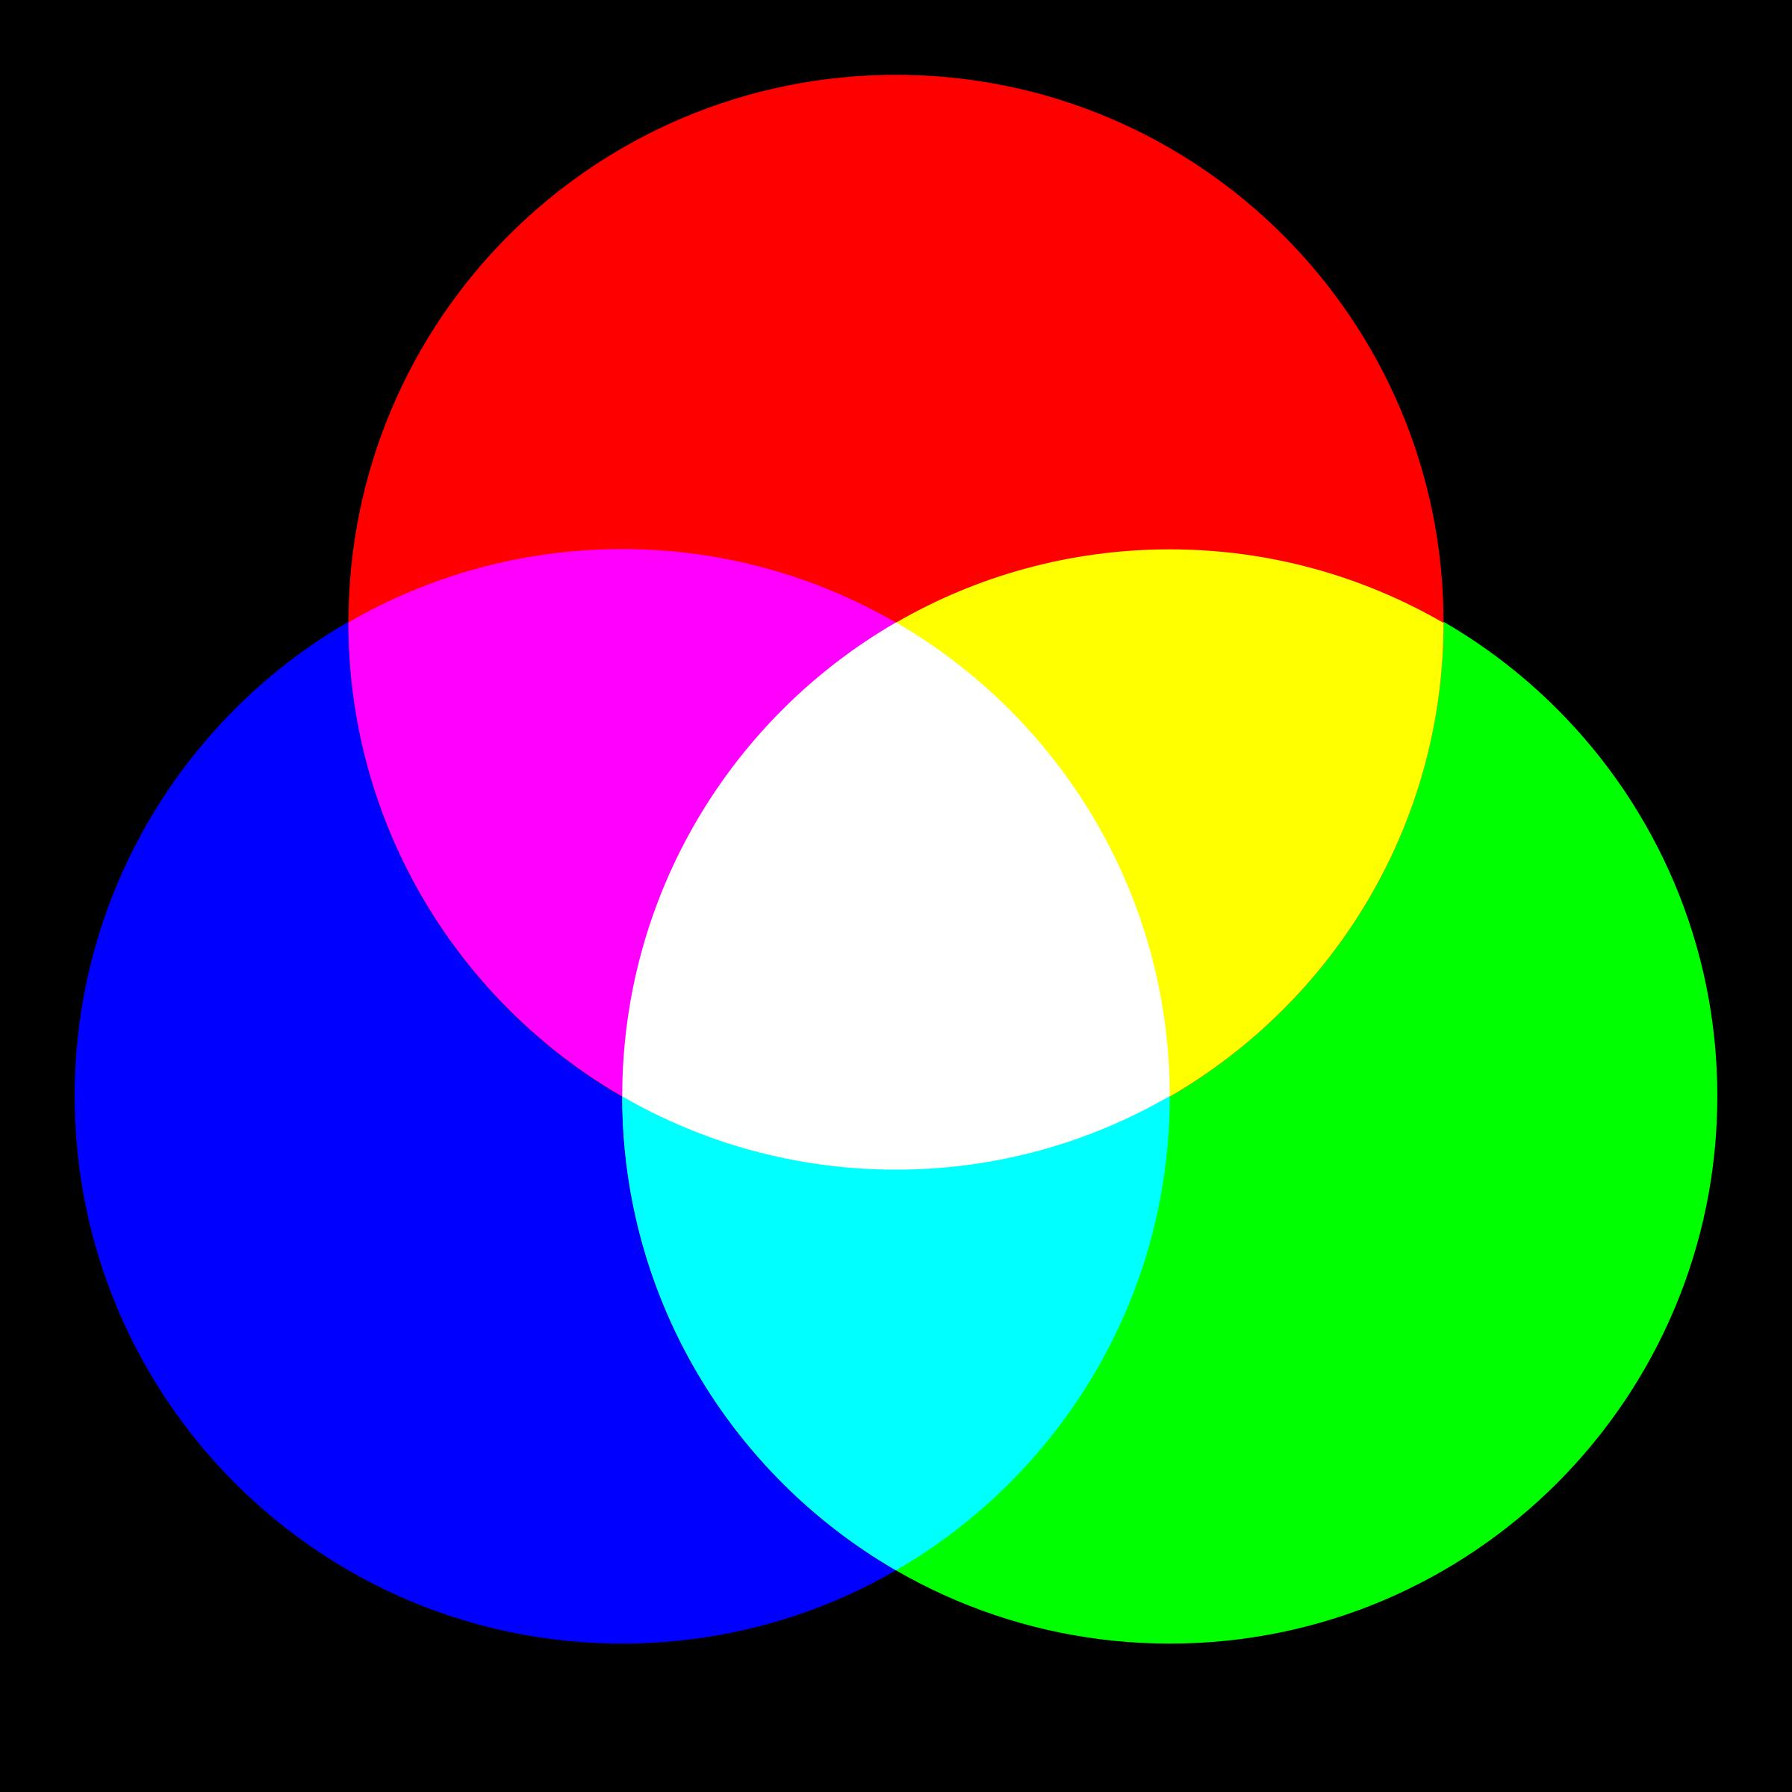
Make a prediction
Answer questions a. and b. in Color Filters, Part I of your Spectrum Notebook
Do NOT look through any of the colored gels before making your prediction!
1
2
3
4
Notes:
Students should answer questions a & b in Color Filters Part 1 their Spectrum Notebook before moving forward.

Slide 13
Check your prediction
Look at this image through the RED colored gel. What do you see?
1
2
3
4
Notes:
Give students time to complete their observation with the red gel before moving on.
Invite students to share whether they are surprised by what they see.
Have someone describe out loud what they are seeing. (This helps to make sure everyone is on the same page. We don’t expect anyone’s computer to display the circles very differently, but you never know.)
You should see that the red circle is still red, while the blue and green circles disappear or look black.
Depending on the students’ monitors or the classroom projector, the red gels might not completely block out blue and green light, so some people might still see the blue or green circles very faintly through the red gel.
Before moving on to the next slide, ask students to predict (in the chat, silently to themselves, or out loud) what they expect to see if they switch to the BLUE gel.

Slide 14
Check the other gels
Now look through the BLUE colored gel. What do you see?
1
2
3
4
Notes:
There will probably be fewer surprises here, but ask someone to describe what they are seeing just in case.
You should see that the blue circle is still blue, while the red and green circles disappear or look black.
Depending on the students’ monitors or the classroom projector, the blue gels might not completely block out red and green light, so some people might still see the red or green circles very faintly through the blue gel.
Ask students to predict what the circles will look like through the green gel..

Slide 15
Check the other gels
Now look through the GREEN colored gel. What do you see?
1
2
3
4
Notes:
Students should be noticing a pattern now.
They will see the green circle, maybe with a hint of the red and blue circles
Encourage students to try to come up with some mental model that might explain what is happening. (They don’t really have to know now - they will work with the Phet simulation to explore in more detail - but it can help to get them wondering and priming their circuits with ideas now.)

Slide 16
Now what do you think?
Answer questions c. and d. in Color Filters, Part 2 of your Spectrum Notebook
1
2
3
4
Notes:
Have students complete parts c & d in their spectrum notebook

Slide 17
Discuss with your partner
Answer question e. in Color Filters, Part 2 of your Spectrum Notebook
1
2
3
4

Slide 18
Photons & Color
and
Color Mixing
Open the Photons & Color section of Module 1: Light in the Spectrum Tool
Complete all questions in the Photons & Color and Color Mixing sections of your Spectrum Notebook as you work through the PhET Simulation.
1
2
3
4
Notes:
Give students time to complete the accompanying questions in the Spectrum Notebook.
Move on to the next slide when students get to Section 4 of the Notebook questions, so they have it available for reference when answering those questions.
https://phet.colorado.edu/sims/html/color-vision/latest/color-vision_en.html

Slide 19
How Light Behaves
What are the behaviors of light that we have learned about?
Which behaviors have we observed so far?
Notes:
Allow students to share their thoughts. Answers will appear in the following slides in this order:
Emission
Absorption & Transmission
Reflection
You can go through these quickly if the review isn’t needed by most of your students, or you can go through more slowly to check understanding as needed.
Homework suggestion
Complete any unfinished challenges from today’s session

Slide 20
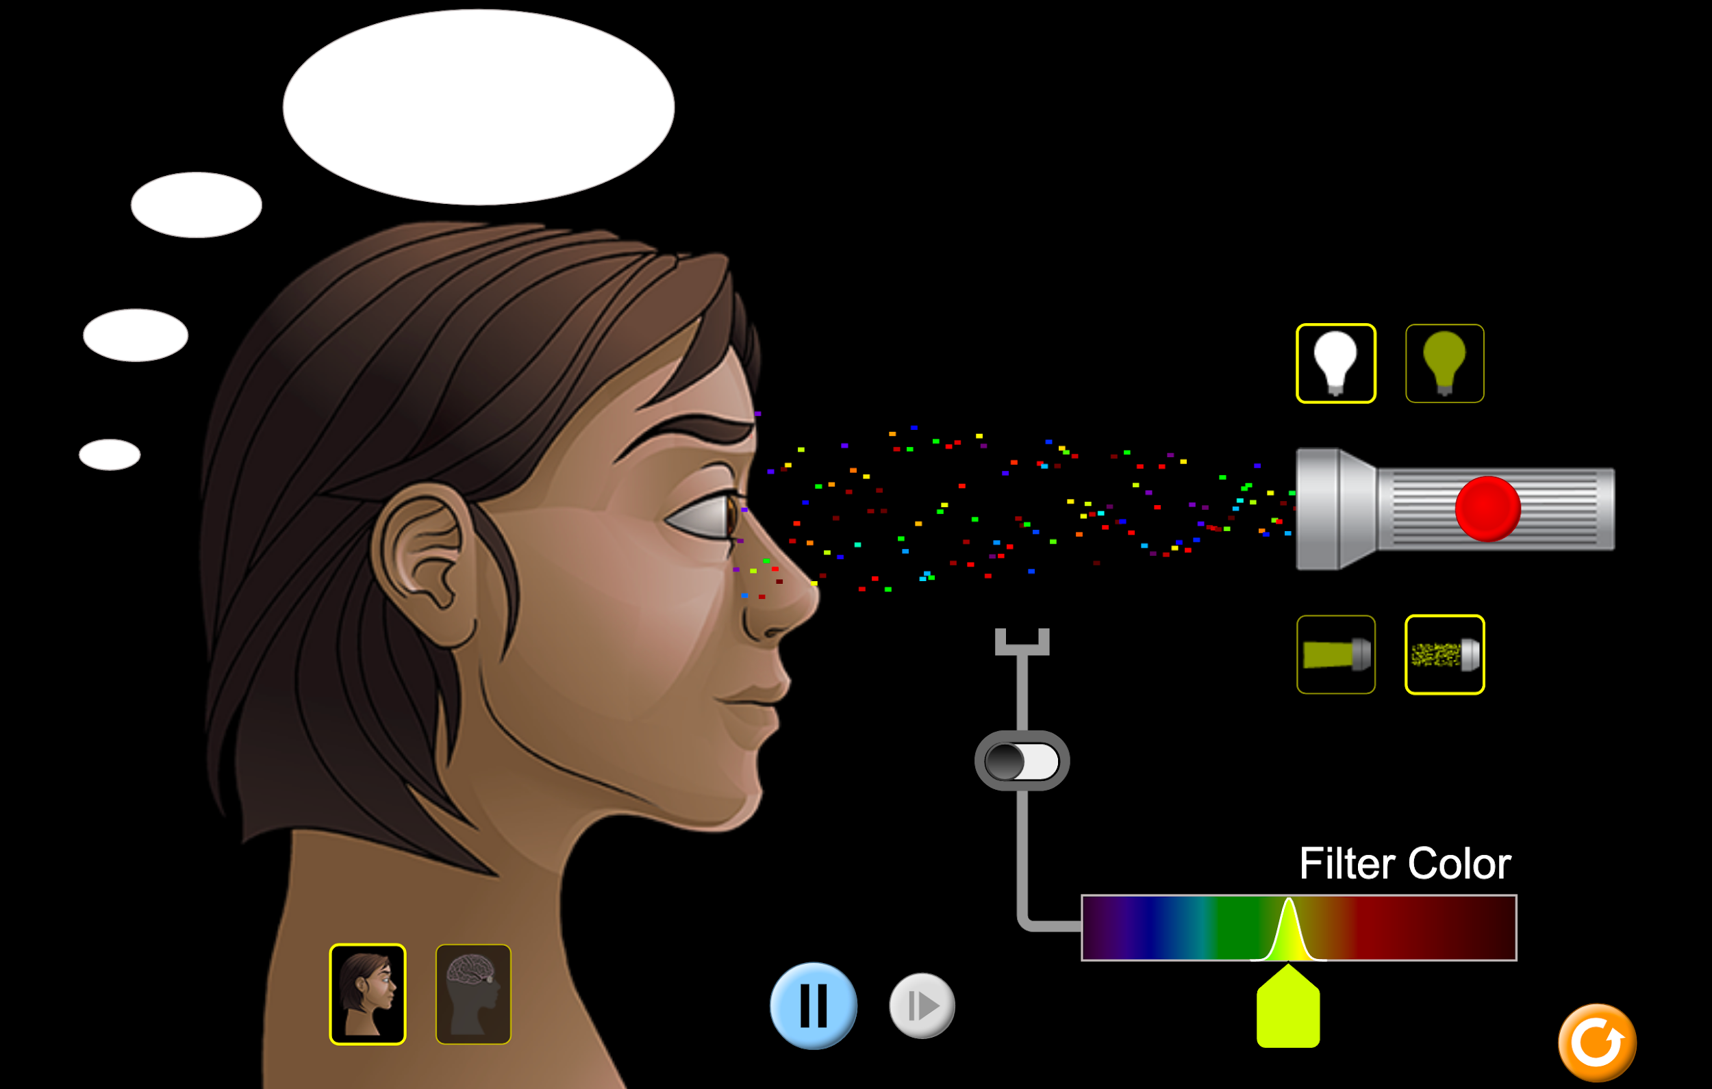
How Light Behaves
Emission
photons are given off by an object
(as from a light bulb or a star)
https://phet.colorado.edu/sims/html/color-vision/latest/color-vision_en.html
Notes:
The flashlight is emitting photons/light.

Slide 21
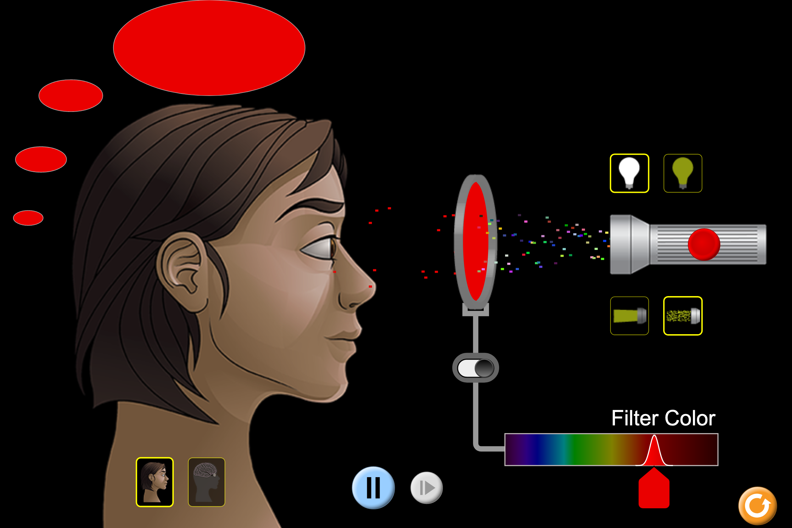
How Light Behaves
Q. What is being absorbed and what is being transmitted by this red filter?
Absorption
photons are taken up by a substance
Transmission
photons pass through a substance
(as with a colored filter)
https://phet.colorado.edu/sims/html/color-vision/latest/color-vision_en.html
Notes:
Red light is transmitted through the red filter.
All other colors of light are absorbed by the red filter.

Slide 22
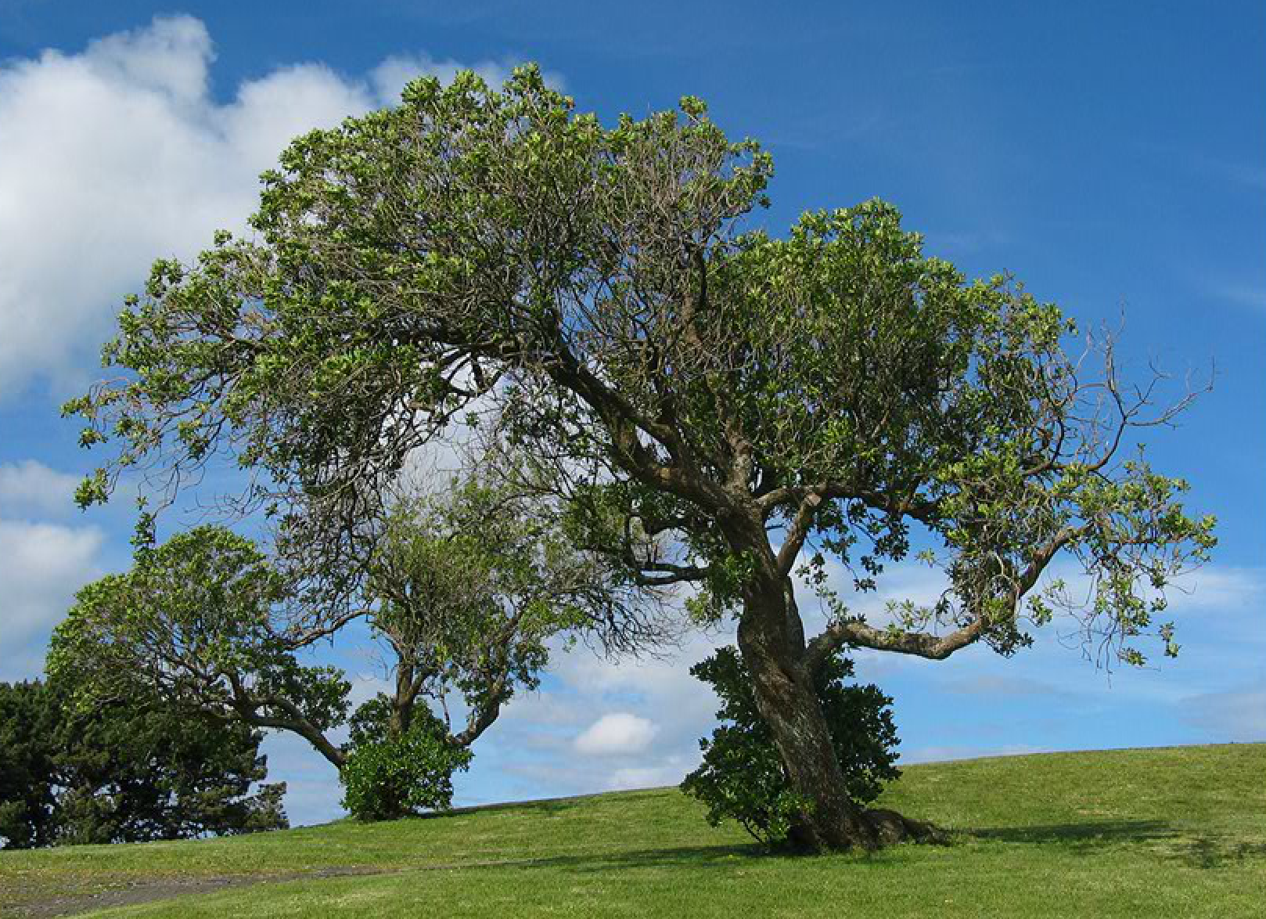
How Light Behaves
Reflection
photons bounce off a substance
(as a leaf or car’s paint)
Scattering
photons reflect off a substance in random directions
(as sunlight off air molecules in our sky)
Why is a leaf green? Why is the sky blue?
Notes:
Emphasize that scattering is a type of reflection.
A leaf is green because it reflects mostly green light and absorbs other colors.
The sky is blue because blue photons tend to bounce off air molecules in the atmosphere in random directions, scattering toward our eyes.
(For the extra curious: Blue photons are matched in size with molecules in the atmosphere, which is why they scatter more easily. Other color photons tend to be transmitted through the atmosphere. At sunrise and sunset, the sun looks red because sunlight has to travel through the longest airpath when it is low in the sky. With a long airpath, most of the blue light has scattered away in random directions, so most of the light that is transmitted includes only redder photons.)

Slide 23
Reconsider these circles
Answer Question 1 in Section 4 of your Spectrum Notebook,
then move on to answer Questions 2-4.
1
2
3
4
Notes:
Display this for Section 4, Q1.

Slide 24
RE-POLL When green glass is placed between the flashlight and the white movie screen, a green spot appears on the screen. If both a green glass and a red glass are placed between the flashlight and the movie screen, what will happen to the spot?
It will turn green.
It will turn yellow.
It will turn brown.
It will turn red.
It will disappear.
1
2
3
4
Notes:
When there are about 6-7 minutes left in class, or after most students have had a chance to complete the Module 1: Light Spectrum Notebook questions, bring them back to this polling question. Follow up with a discussion on how their thinking about this might have changed.
(If students haven’t finished the Notebook questions, they may do so for homework).

Slide 25
End of Module 1: Light
What questions do you still have?
1
2
3
4
Notes:
Wrap up discussion
For homework - students can complete any unfinished challenges from today’s session

