Slide 1
Final Project
Create and Light a Saltwater Aquarium
Create and light a saltwater reef aquarium that is healthy, and looks great too.Create and light a saltwater reef aquarium that is healthy, and looks great too.
Notes:
In this project, students will design a saltwater aquarium. They will choose the tank’s inhabitants and then light the tank to both keep the plants healthy and look aesthetically pleasing

Slide 2
Explore Lighting Design
Students watch the video on the SpecLab website to learn how a Smithsonian Lighting Designer uses light to enhance art.Create and light a saltwater reef aquarium that is healthy, and looks great too.Create and light a saltwater reef aquarium that is healthy, and looks great too.

Slide 3
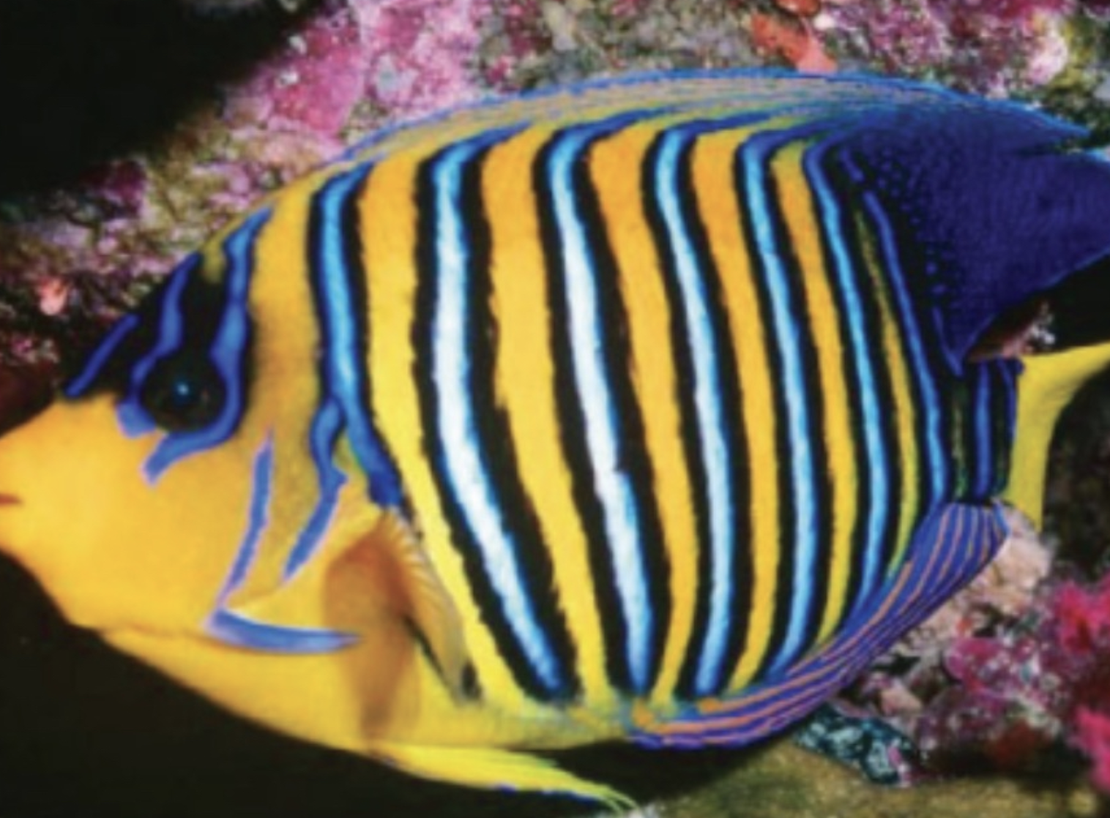
Fish Reflection Spectra and Colors
Students can explore the spectra of different colors of the Regal Angel Fish
They can use the Phet Simulation for a refresher on how light colors mix

Slide 4
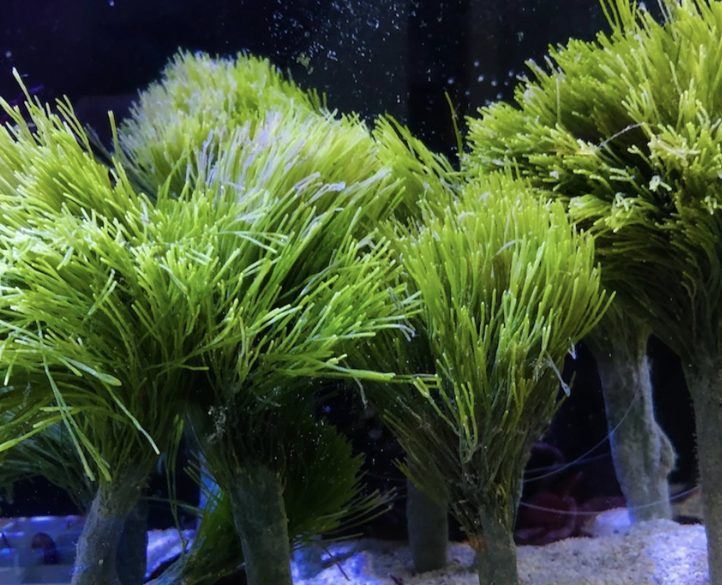
Saltwater Plant Reflection Spectra
Students can explore the spectra of Chlorophyll a - they’ll use this later in the project

Slide 5
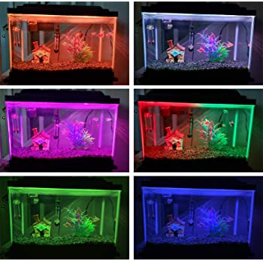
Your Fish Tank
C
Students choose which plants (algae) and animals (fish and coral) to live in the tank
Then they a lighting scheme for the tank that best suits the needs of its inhabitants and is aesthetically pleasing to them

Slide 6
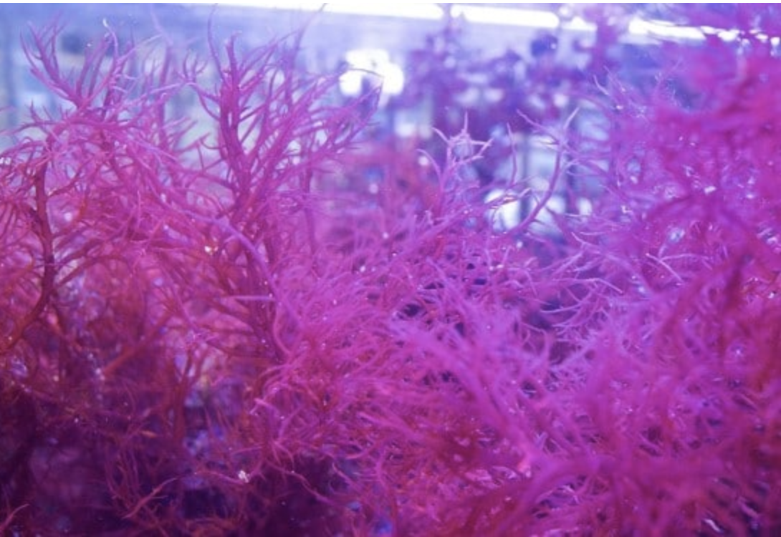
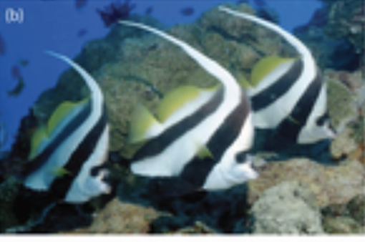
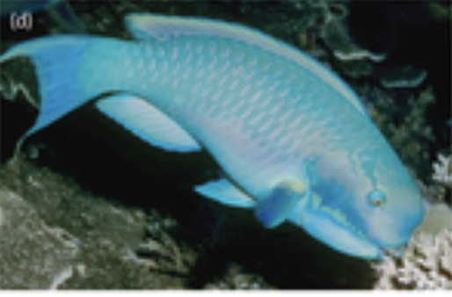
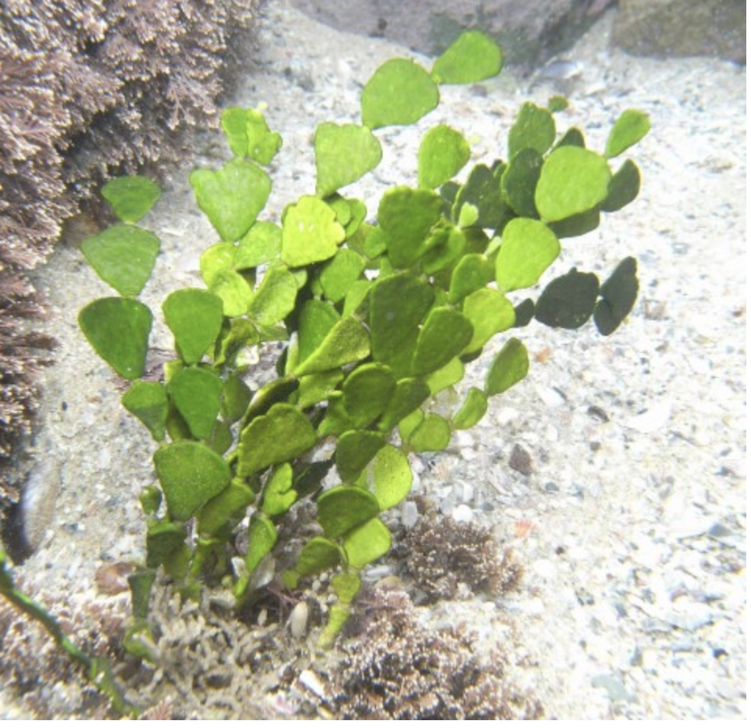
Choosing Plants and Animals
Students use the FIshtank Data Chart to choose plants and animals for the tank and complete questions in the student notebook.
Notes:
Students should review the Fishtank Data Charts to learn about different types of fish, plants and coral before choosing how to inhabit their tank. For this part of the activity, they are choosing creatures based on the needs of the overall tank. They should consider: Which plants and animals are compatible with one another and Which are the most aesthetically pleasing? Students should complete Part I in their student notebook.

Slide 7
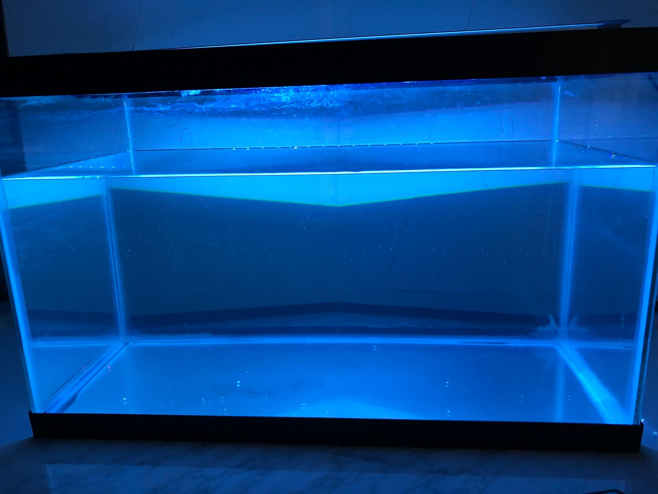
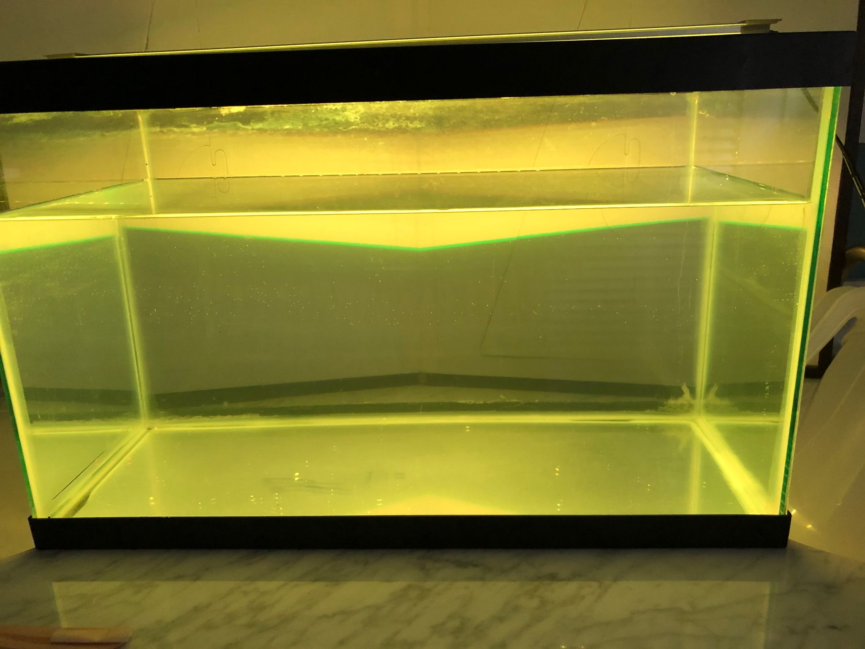
Lighting Your Tank
Students use the spectrum charts in the FIshtank Data Charts to complete questions in the student notebook.
They choose a color to light the tank using The PheT simulation, draw the spectrum of this color in the Spectrum Tool and complete questions in the student notebook
Describe what the inhabitants might look like under these lights and complete Part IV of student notebook
Use all of the information gathered in Parts I-IV to answer Part V in student notebook
Notes:
Students should return the Fishtank Data Charts to review the spectra for their chosen fish, plants and coral before For this part of the activity, they are choosing lightning based on the needs of the plants and animals. They should consider: Are the plants or coral photosynthetic? If so, what color light is absorbed? reflected? What colors do the fish reflect? - Note that multicolored fish reflect in different wavelengths. Students should complete Part II in their student notebook. Students then choose a color to light the tank using the Phet Simulation, then draw the spectrum of this lighting scheme in the Spectrum Lab. Students then describe what the plants look like under their light (they only know for sure the colors reflected from the photosynthetic plants and algae - they’ll have to make their best guess for the non-photosynthetic plants). For example, students should remember from earlier in the project and in previous sessions that the yellow coral may reflect red and green photons or yellow photons. Students should be able to color the fish using data from the reflection charts.

Slide 8
Put it Together
C
Students use all the information they’ve gathered during the project to write a paragraph that describes the set-up for their tank including what creatures they’ve chosen to live in the tank, what lighting scheme they’ve chosen for their tank and why they’ve made these choices

